Slide 1
Anomaly Detection in Host Log Files
Kate Stadelman

Slide 2
Research Question
Anomaly Detection in Host Log Files
Can we detect suspicious user activity hidden
in massive computer log files?

Slide 3
Unified Network & Network Data Set
“A subset of network and computer (host) events collected from the Los Alamos National Laboratory enterprise network over the course of approximately 90 days.”¹
Details
Microsoft Windows Computers
Logs Deidentified for Security
Day One: 55.6M Events

Slide 4
Hacking 101
Low-Level User
Gain Access to a Computer with a Low-Level User
Escalate Privileges (to Administrator)
Run Harmful Code
Hijack Processes
Steal / Destroy Data
Breach Other Computers on the Network
Administrator

Slide 5
Computer (Host) Events
Connect Logs By
Event Time
Computer (Host) Name
User Name
Logon ID
Windows Authentications (Kerberos)
Logins Using Explicit Credentials
Login Failures (with Reason Codes)
Special Privileges Assigned to Login
Process Started / Stopped
Computer Locked / Unlocked
Screen Saver Started / Stopped

Slide 6
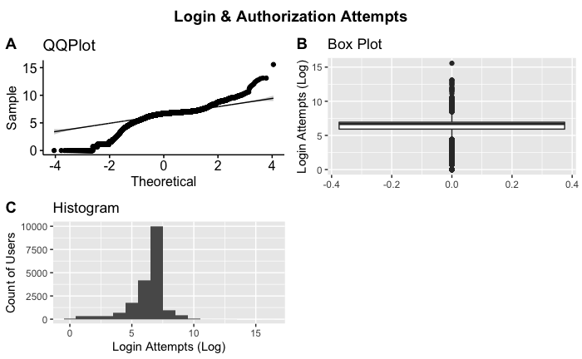
Log Aggregation
Counts by User
Login Attempts
Login Failures
Hosts Accessed
Privileged Actions
Processes Started
Mapped Credentials
19,220 Users

Slide 7
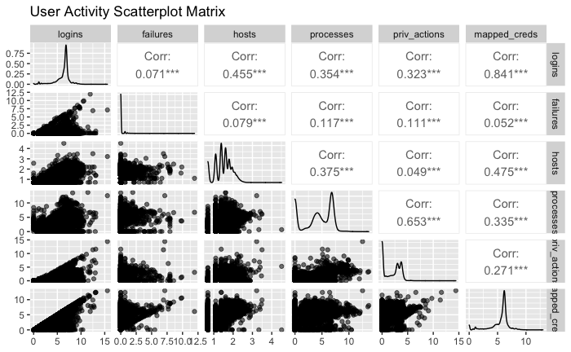
Variable Check
19,220 Users

Slide 8

Isolation Forest
Which One is Different?
First Presented in 2008
Developed for Anomaly Detection
Unsupervised Tree Ensemble Method
Extension of Random Forest
Scales Well for Large Data Sets

Slide 9

Data Requirements
Bad Data? Isolation Forest STILL WORKS
High-Dimension Problems
Data is Not Well-Behaved
Large Number of Irrelevant Attributes
Small Training Sets
Training Sets Without Anomalies

Slide 10
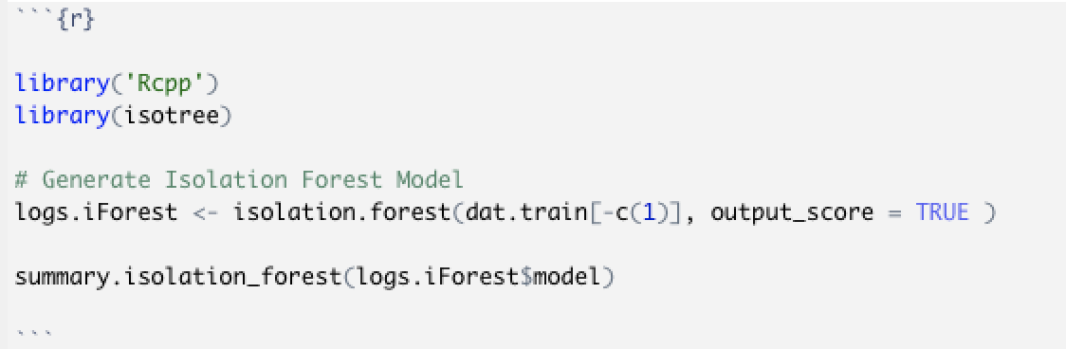
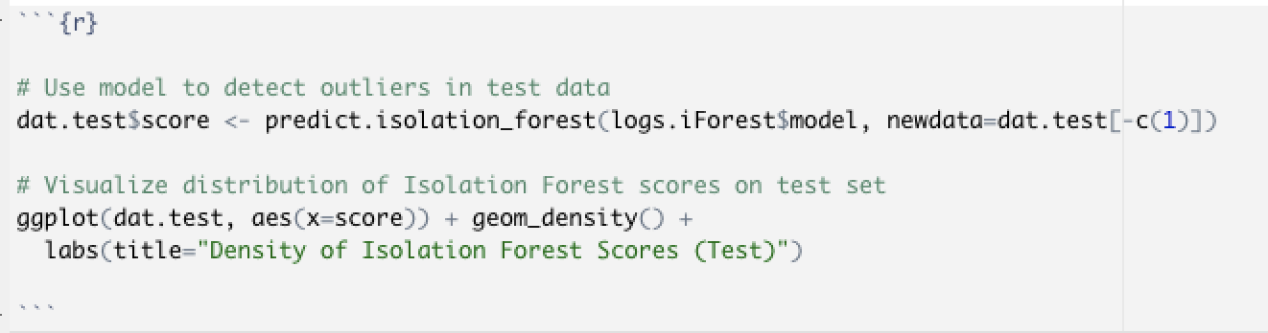
isotree Package
Process
Split Data (50%/50%)
Train Model
Review Output
Pick Outlier Threshold
Adjust Parameters
Test Model
Identify Outliers

Slide 11
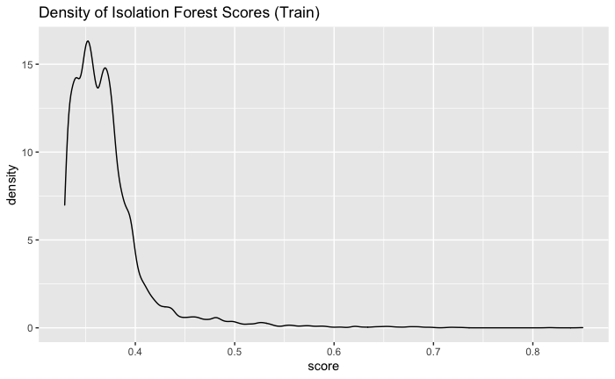
Model Output
Anomaly Scores
Generated for Each Observation
Derived From Average Path Length
Closer to 0.5 Normal
Closer to 1 Outlier
Set Outlier Threshold for Analysis (0.7)

Slide 12
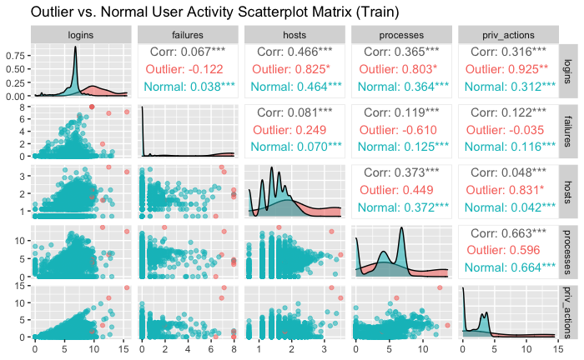
Training Results

Slide 13
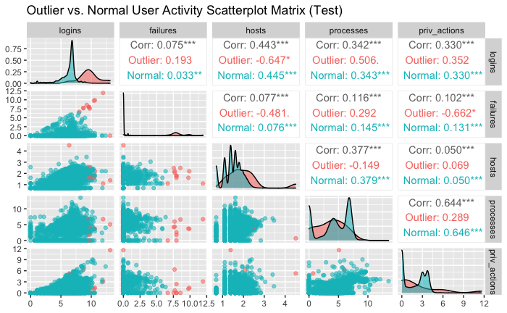
Test Results

Slide 14
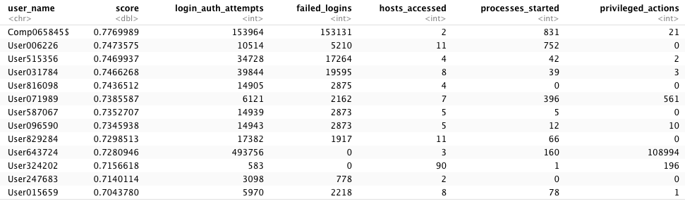
Anomalous Users

Slide 15
Discussion
Q & A

Slide 16
References
Turcotte M., Kent A., & Hash C. (2018, November). Unified Host and Network Data Set. Data Science for Cyber-Security, (1–22). https://www.worldscientific.com/doi/abs/10.1142/9781786345646_001
Liu F. T., Ting K. M., & Zhou, Z.-H. (2008). Isolation Forest. Proceedings of the 8th IEEE International Conference on Data Mining (ICDM’08), Pisa, Italy. https://cs.nju.edu.cn/zhouzh/zhouzh.files/publication/icdm08b.pdf
Zhu, A. & Suresh, S. (2019, December 13). Isolation Forest for Data Mining. Medium. https://medium.com/@siddharth.suresh92/isolation-forest-for-data-mining-a2c44a26d646
Young, A. (2020, November 13). Isolation Forest is the best Anomaly Detection Algorithm for Big Data Right Now. Towards Data Science. https://towardsdatascience.com/isolation-forest-is-the-best-anomaly-detection-algorithm-for-big-data-right-now-e1a18ec0f94f

